Slide 1
Mathematical Foundation of Machine Learning
IV Deep Neural Networks and Dynamical Systems

Slide 2
Outline
More on attention:
Attention Neural machine translatoin by jointly learning to align and translate ICLR 2015
Self-attention long short term memory net for machine reading EMNLP 2016
Transformer Attention is all you need NIPS 2017
Multi-head attention Attention is all you need NIPS 2017
Bert BERT: Pre-training of Deep Bidirectional Transformers for Language Understanding ACL 2019
Generative modeling: introduction

Slide 3
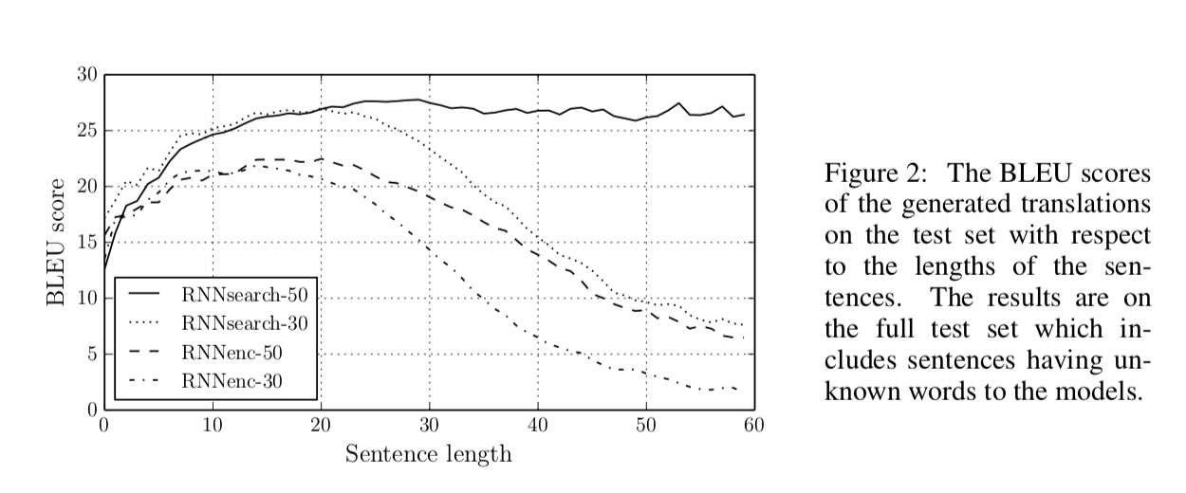
Attention Neural machine translatoin by jointly learning to align and translate ICLR 2015
Revisit Seq2Seq Model
Attention tremendously improves Seq2Seq model.
With attention, Seq2Seq model does not forget source input.
With attention, the decoders revisite all input and knows where to focus.
Downside: much more computation.

Slide 4
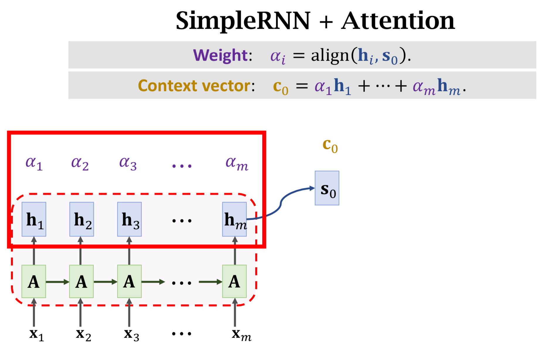
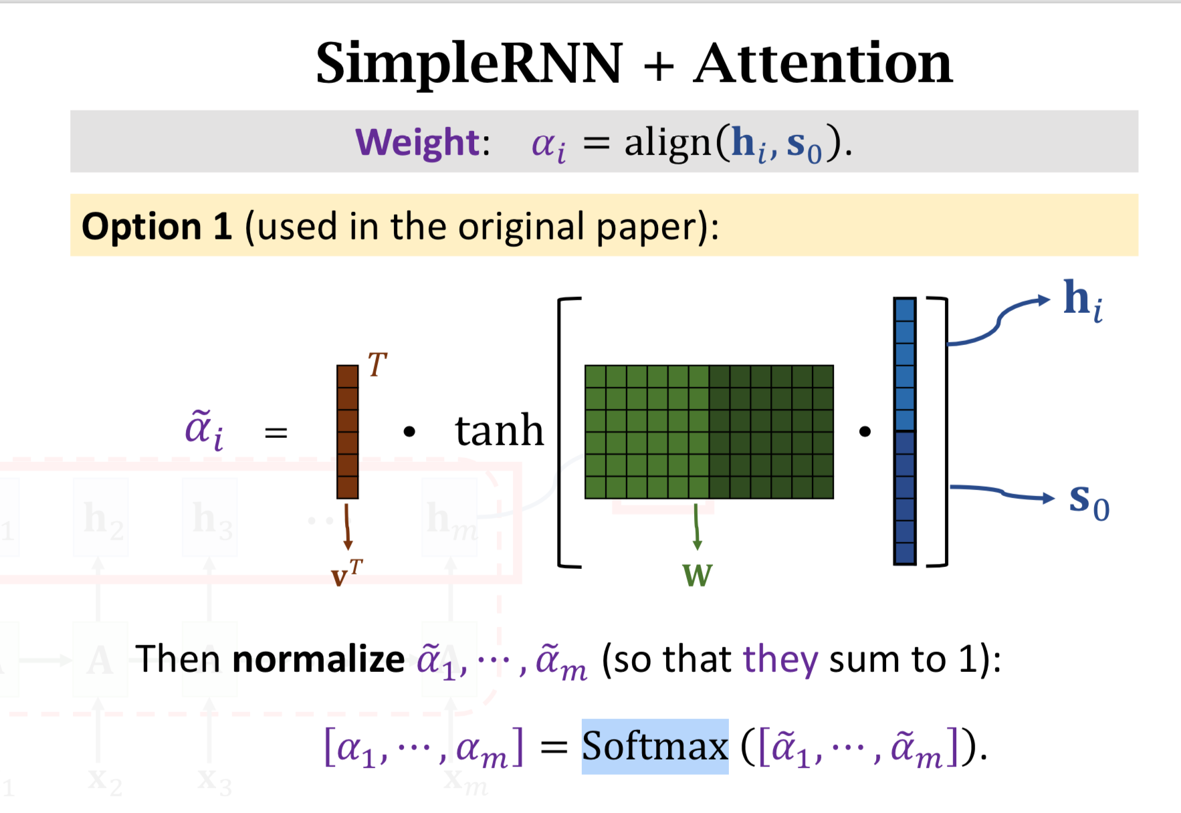

Slide 5
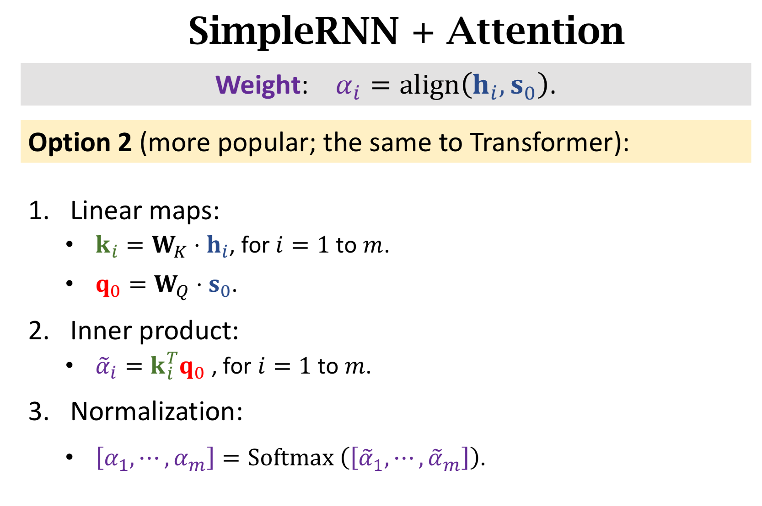

Slide 6
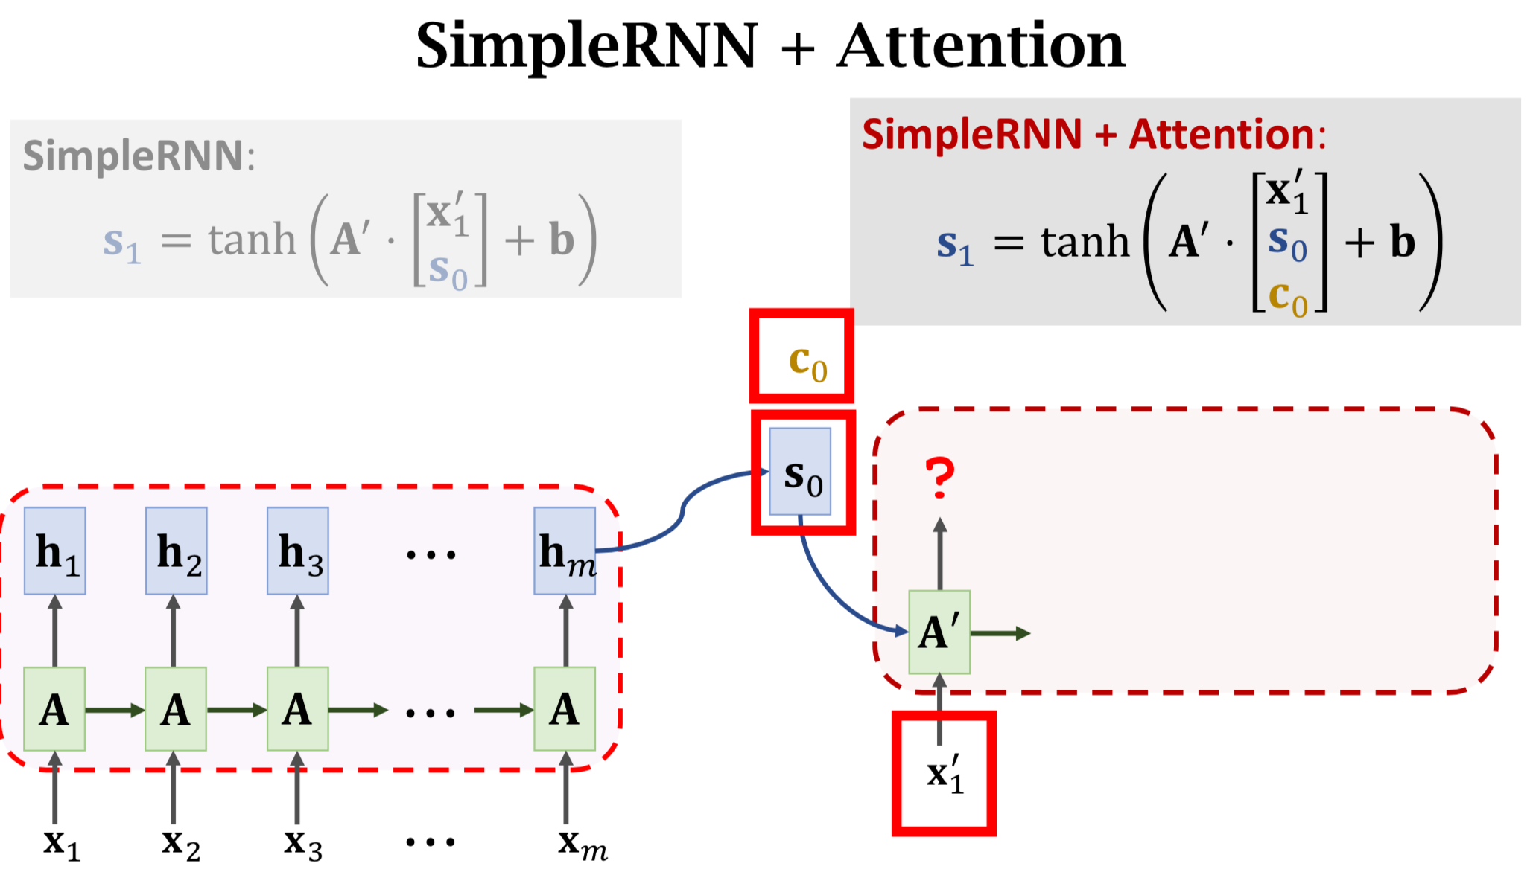

Slide 7
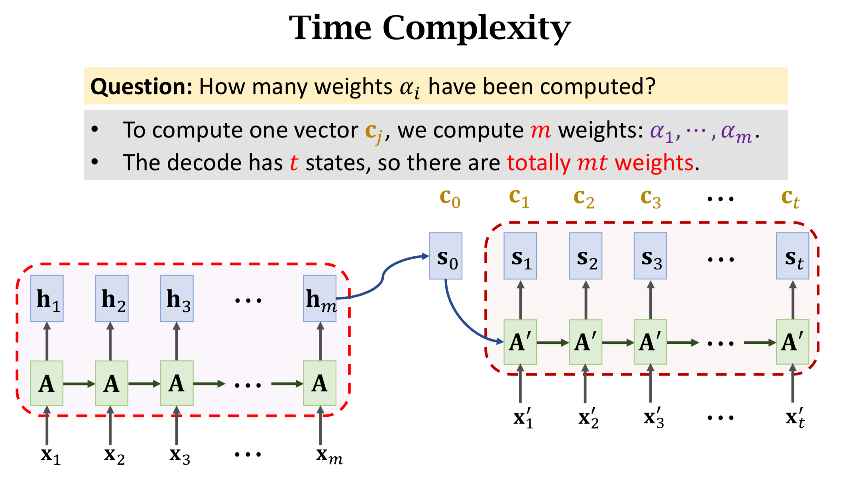

Slide 8
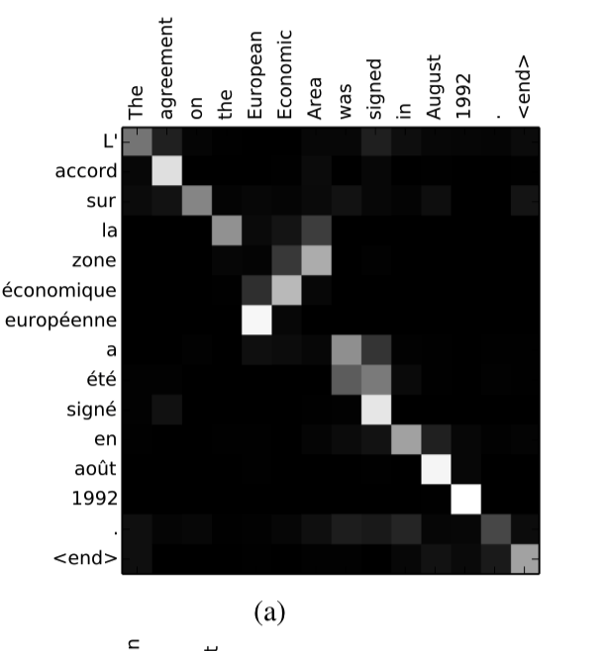

Slide 9
Outline
More on attention:
Attention Neural machine translatoin by jointly learning to align and translate ICLR 2015
Self-attention long short term memory net for machine reading EMNLP 2016
Transformer Attention is all you need NIPS 2017
Multi-head attention Attention is all you need NIPS 2017
Bert BERT: Pre-training of Deep Bidirectional Transformers for Language Understanding ACL 2019
Generative modeling: introduction

Slide 10
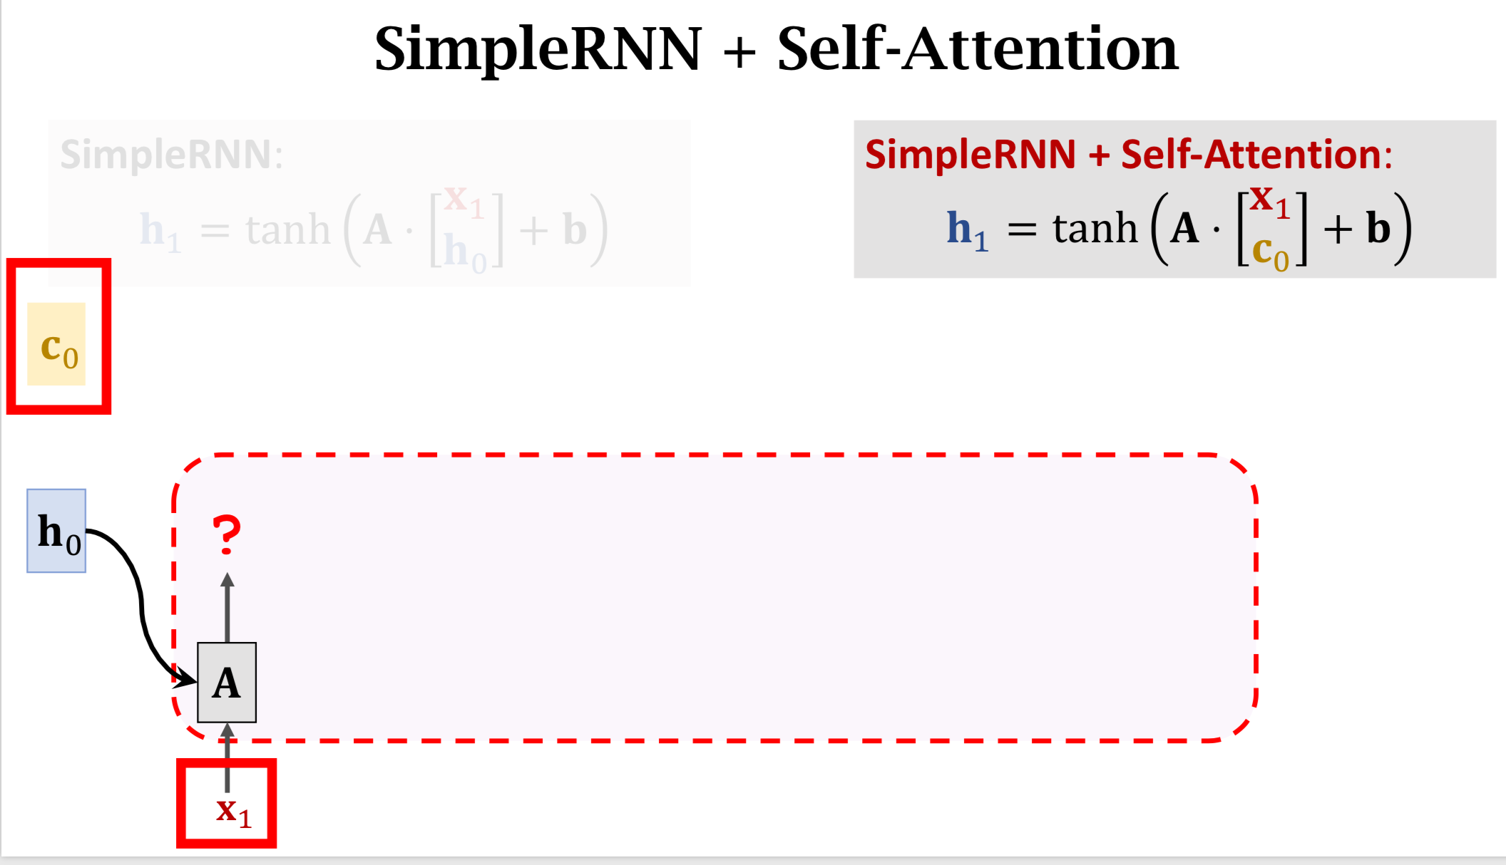
Self-attention long short term memory net for machine reading EMNLP 2016
attention does not have to need Seq2Seq model, it can combine with any model, e.g. just an LSTM model without auto-ecoder.
at iteration j, context vector c_j review all contexts from each h_i（i = 1 to j）

Slide 11
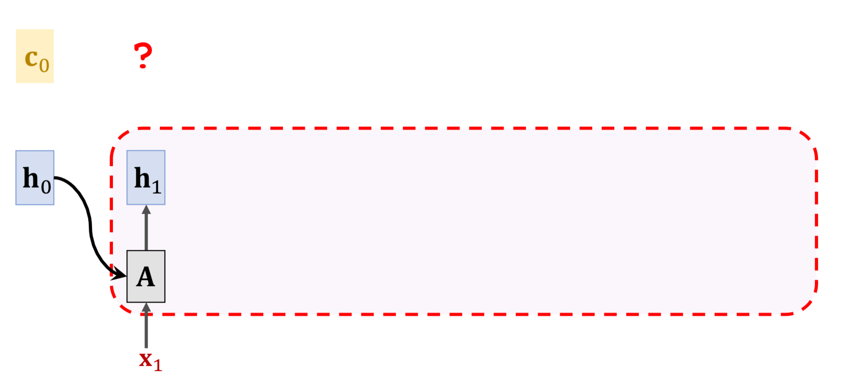
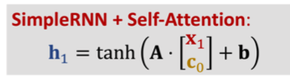

Slide 12
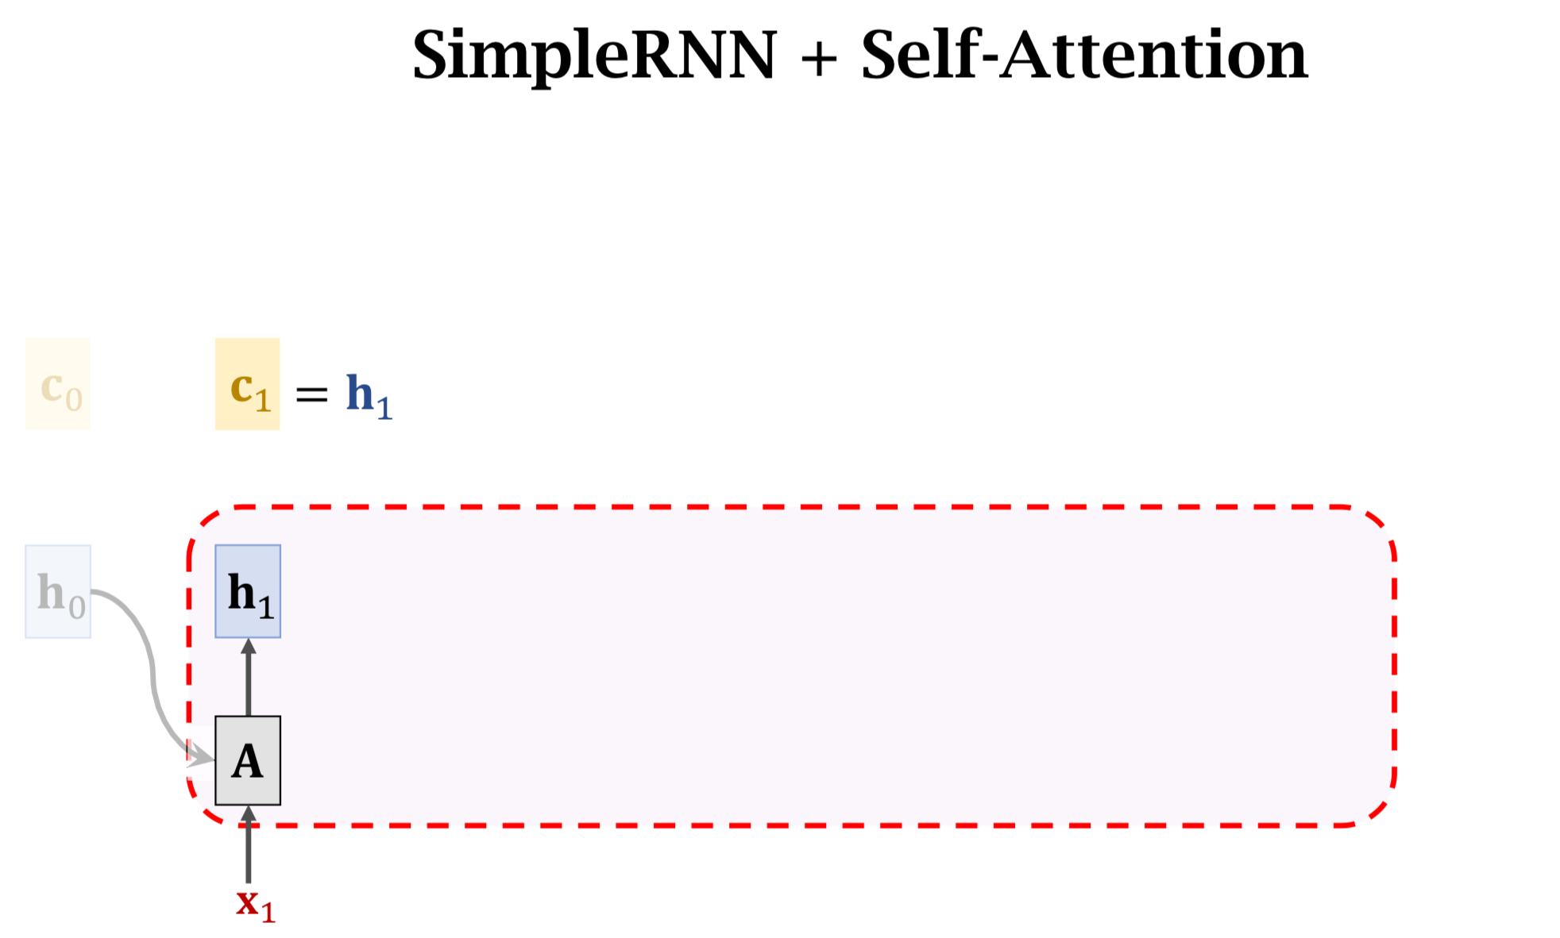

Slide 13
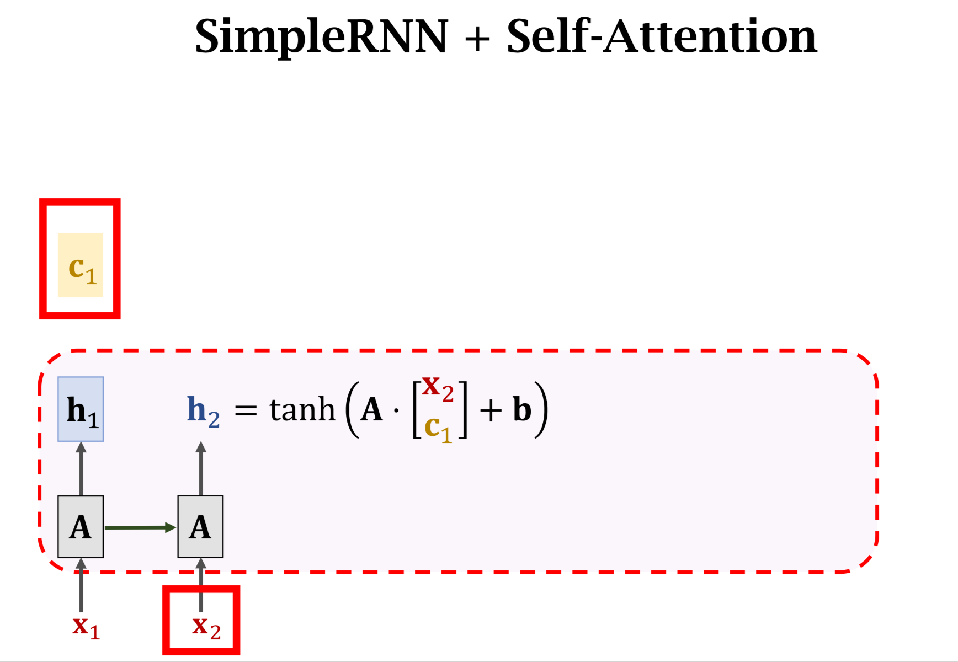

Slide 14
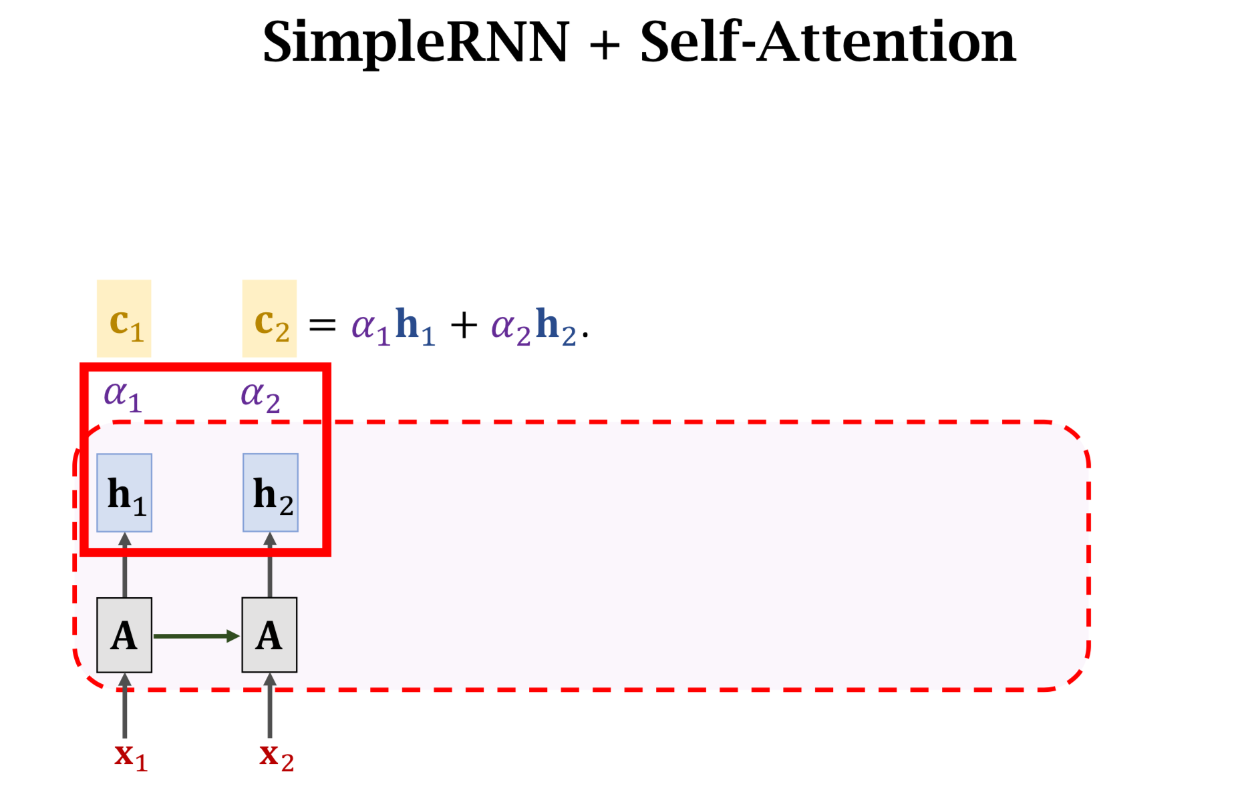

Slide 15
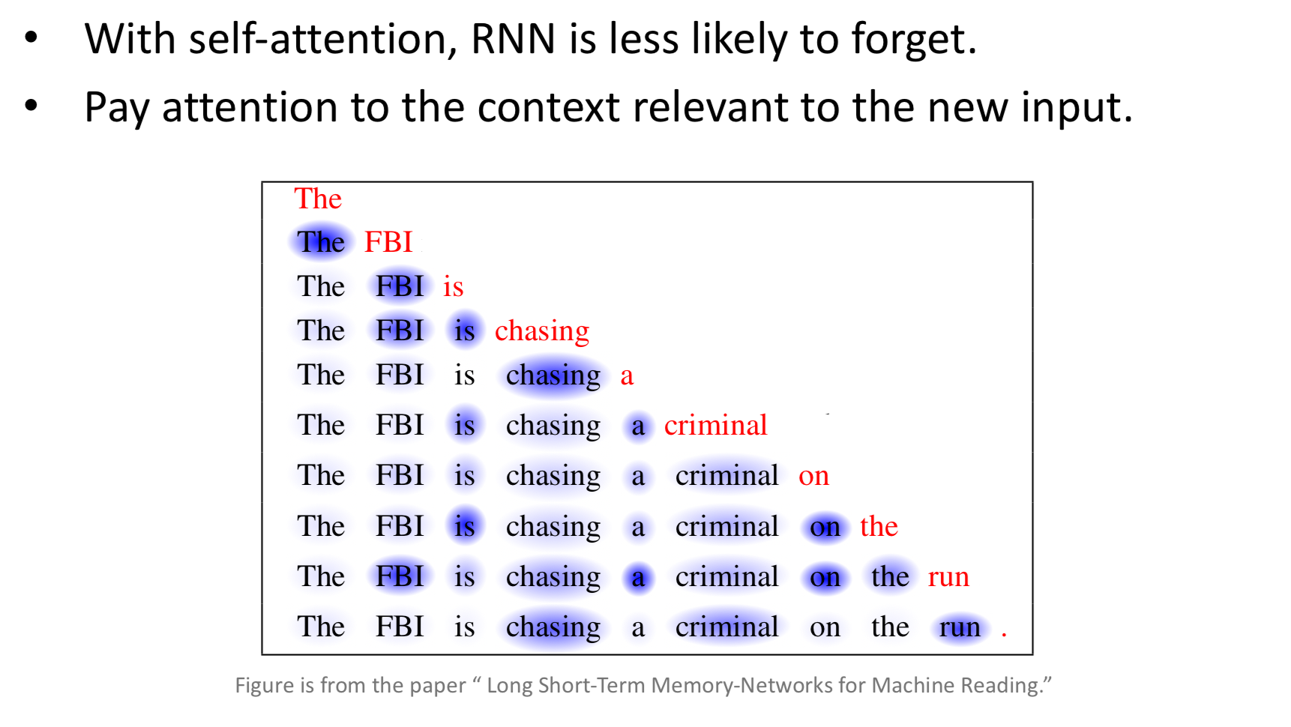

Slide 16
Outline
More on attention:
Attention Neural machine translatoin by jointly learning to align and translate ICLR 2015
Self-attention long short term memory net for machine reading EMNLP 2016
Transformer Attention is all you need NIPS 2017
Multi-head attention Attention is all you need NIPS 2017
Bert BERT: Pre-training of Deep Bidirectional Transformers for Language Understanding ACL 2019
Generative modeling: introduction

Slide 17
Transformer Attention is all you need NIPS 2017
Transformer is a Seq2Seq model
remove RNN, only use attention and dense layers
higher accuracy
Encoder’s inputs are vectors 𝐱_i(i = 1 to m)
Decoder’s inputs are vectors 𝐱'_j(j = 1 to t).

Slide 18
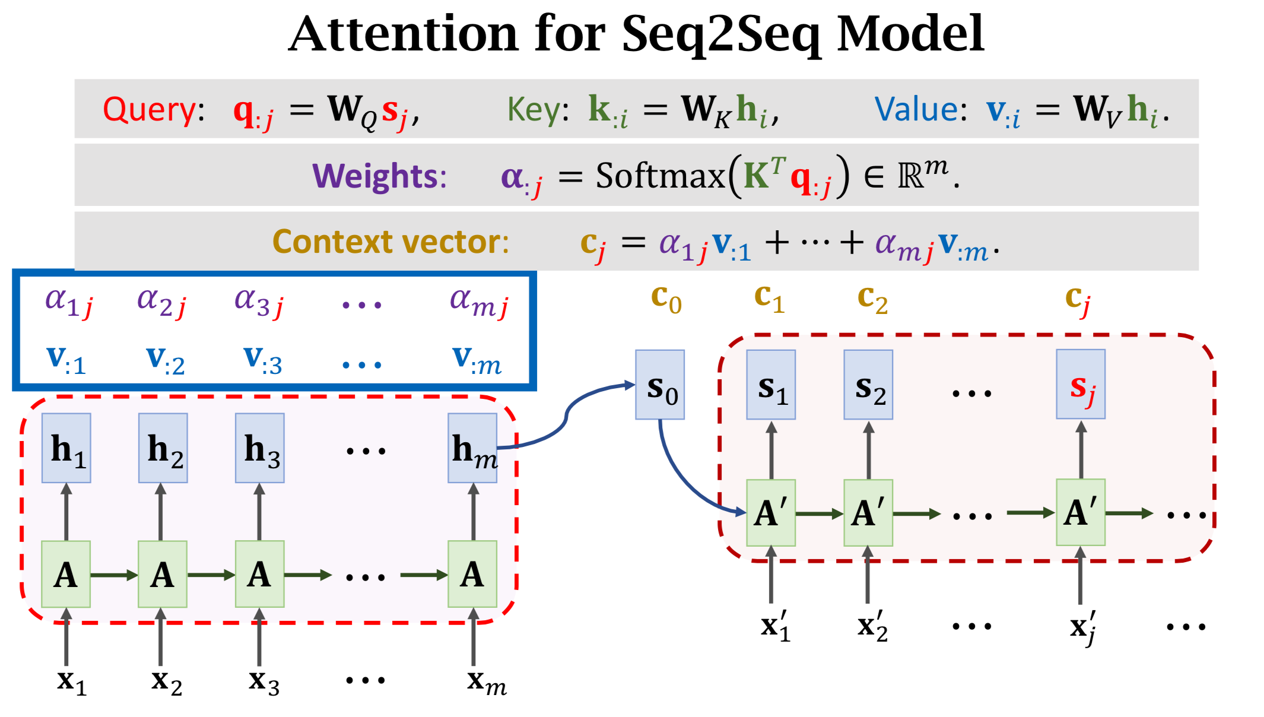
remember RNN+attention: Query j = 1... t ; Key i = 1...m; value i =1...m
How to remove RNN and only keep attention?

Slide 19
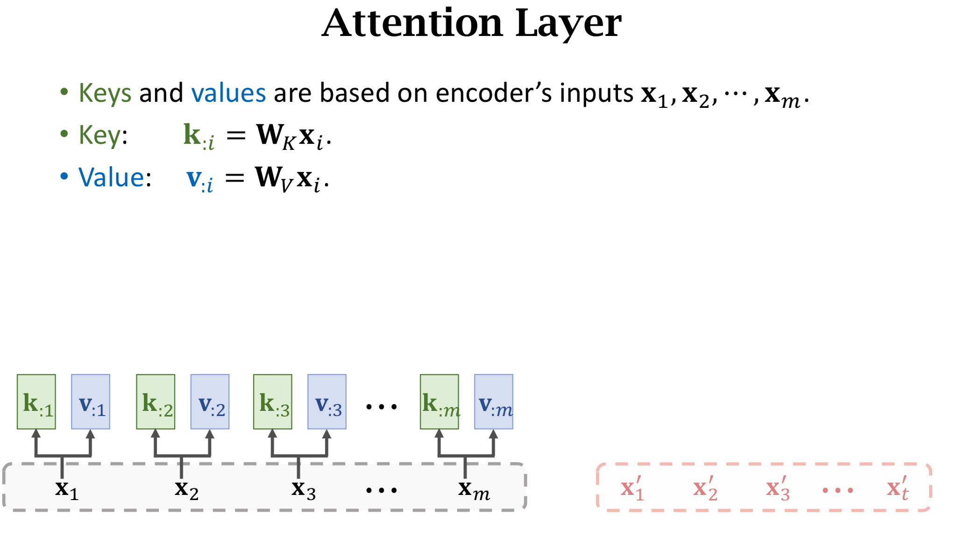
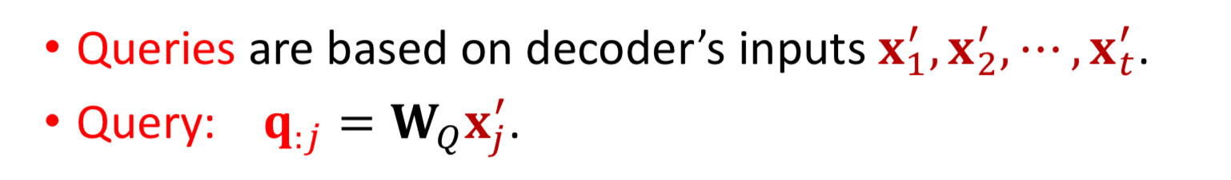
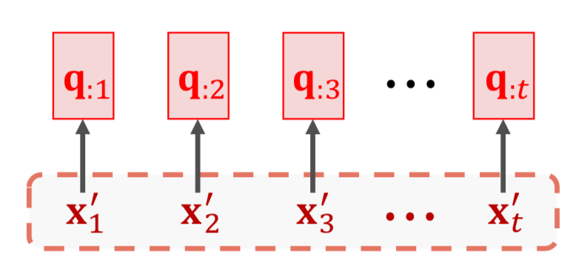
Transformer: pure attention

Slide 20
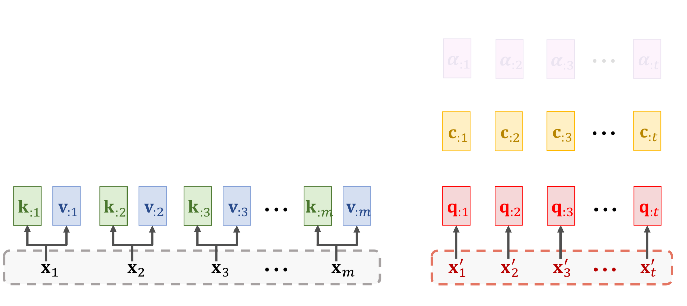
Attention layer

Slide 21
Attention layer
Output of attetion layer

Slide 22
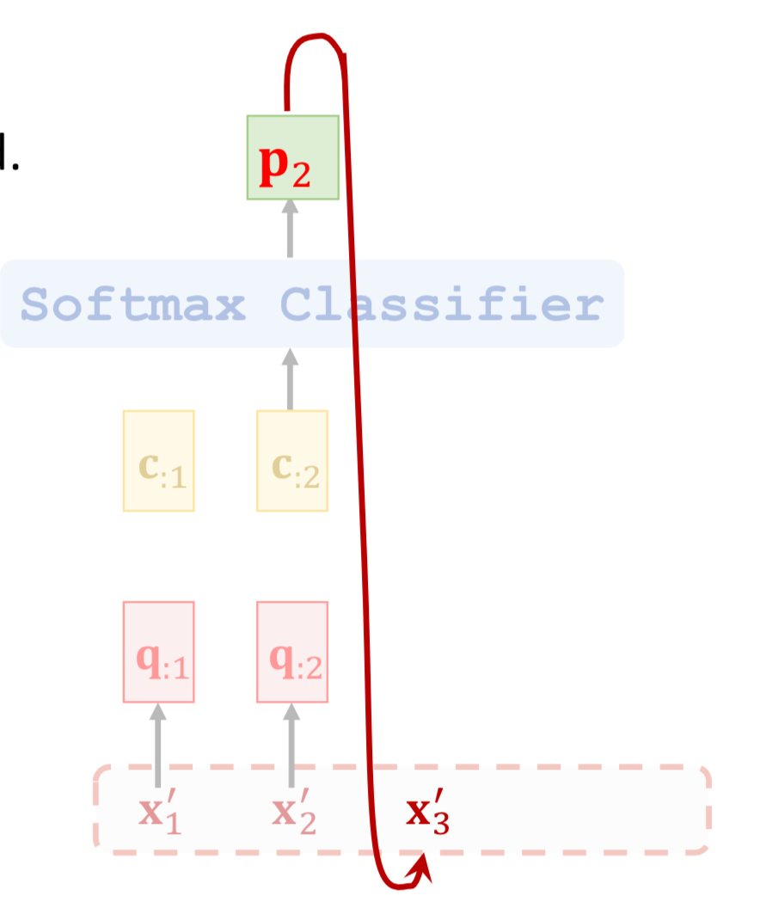
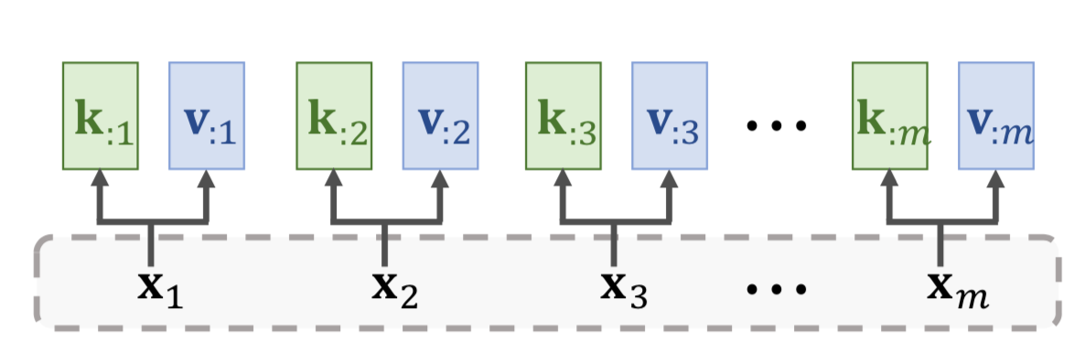
take machine translater for example

Slide 23
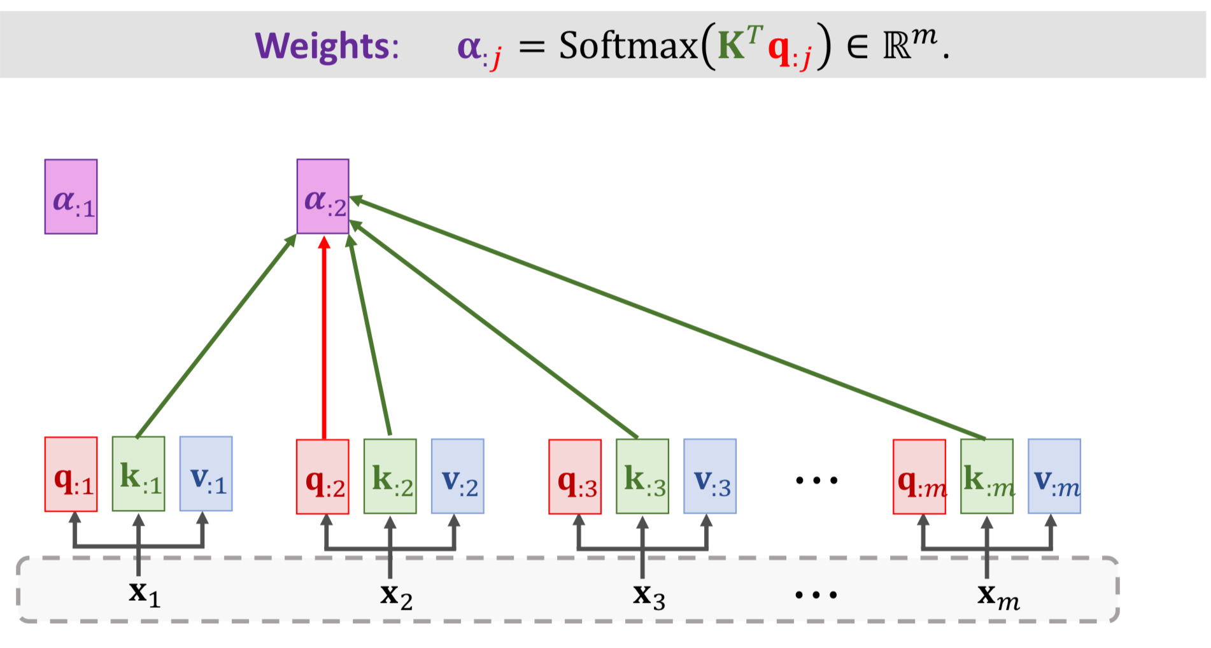
Self-attention Layer

Slide 24
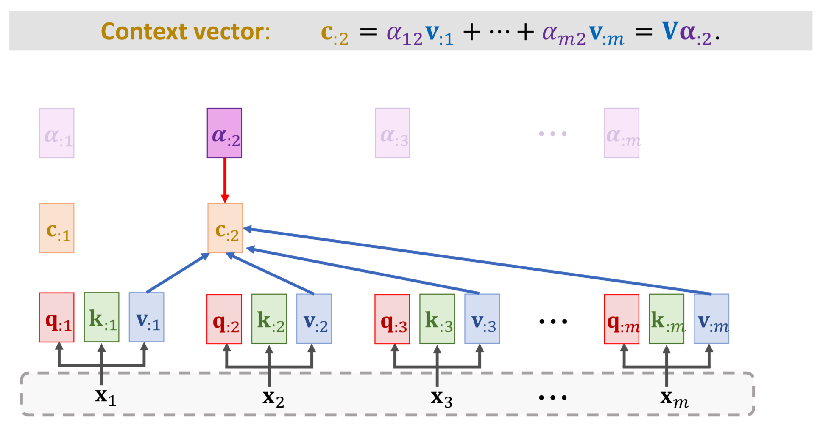
Self-attention Layer

Slide 25
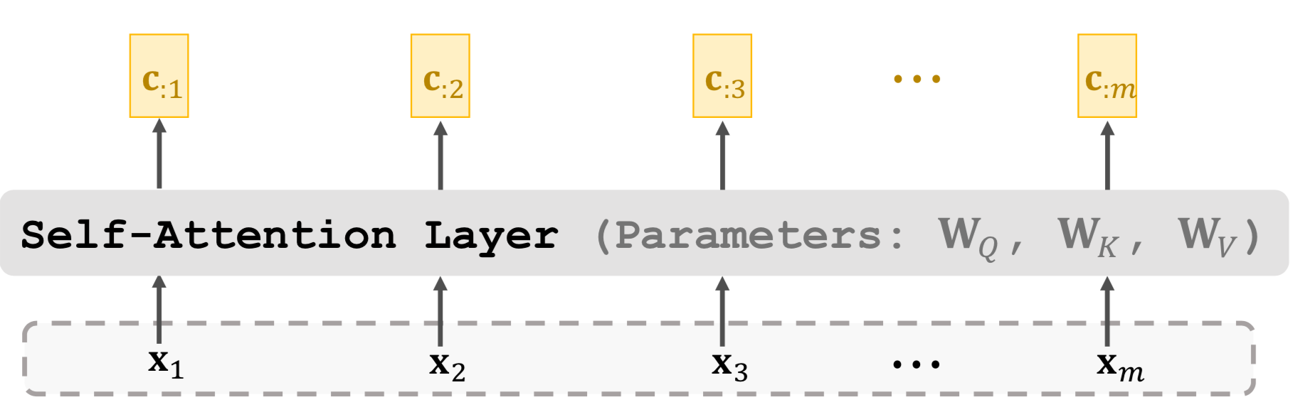
Self-attention Layer

Slide 26
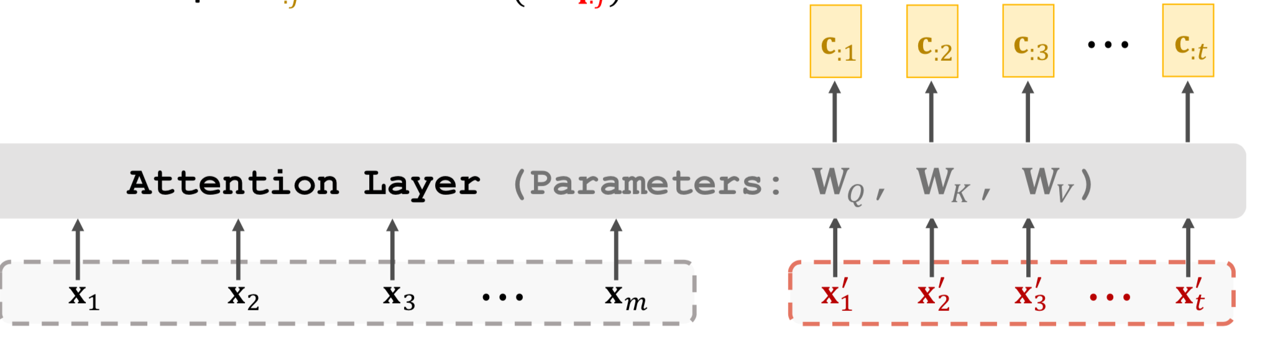
Summary
Attention was originally developed for Seq2Seq RNN models [1].
Self-attention: attention for LSTM models (not necessarilySeq2Seq models [2].
Attention can be used without RNN [3].
We learned how to build attention layer and self-attention layer
Reference:
Bahdanau, Cho, & Bengio. Neural machine translation by jointly learning to align and translate. In ICLR, 2015.
Cheng, Dong, & Lapata. Long Short-Term Memory-Networks for Machine Reading. InEMNLP, 2016.
Vaswani et al. Attention Is All You Need. In NIPS, 2017.

Slide 27
Outline
More on attention:
Attention Neural machine translatoin by jointly learning to align and translate ICLR 2015
Self-attention long short term memory net for machine reading EMNLP 2016
Transformer Attention is all you need NIPS 2017
Multi-head attention Attention is all you need NIPS 2017
Bert BERT: Pre-training of Deep Bidirectional Transformers for Language Understanding ACL 2019
Generative modeling: introduction

Slide 28
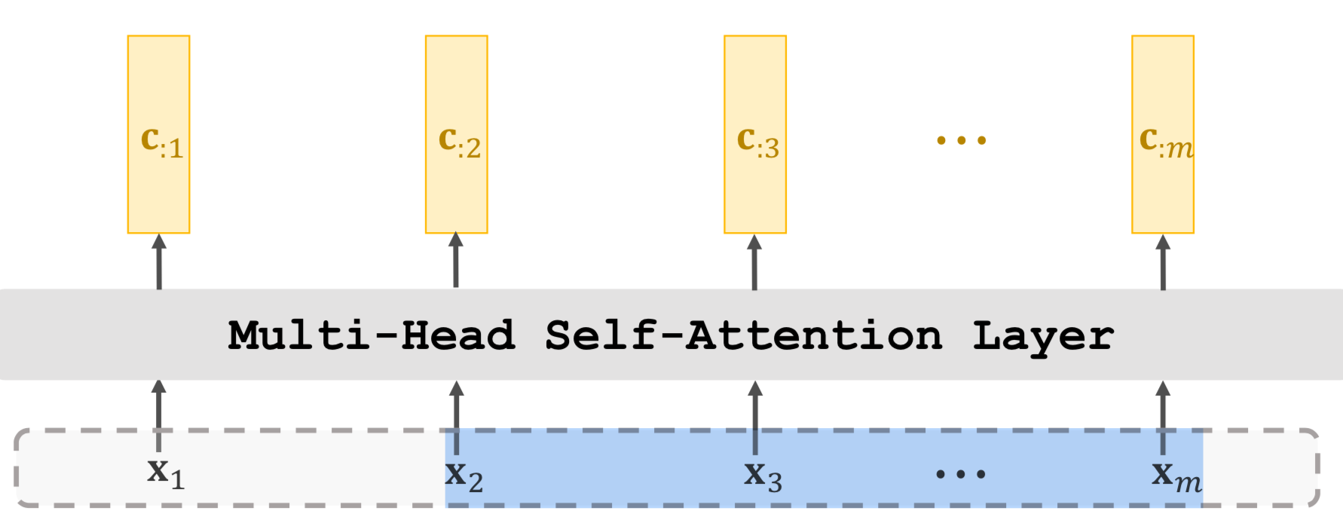
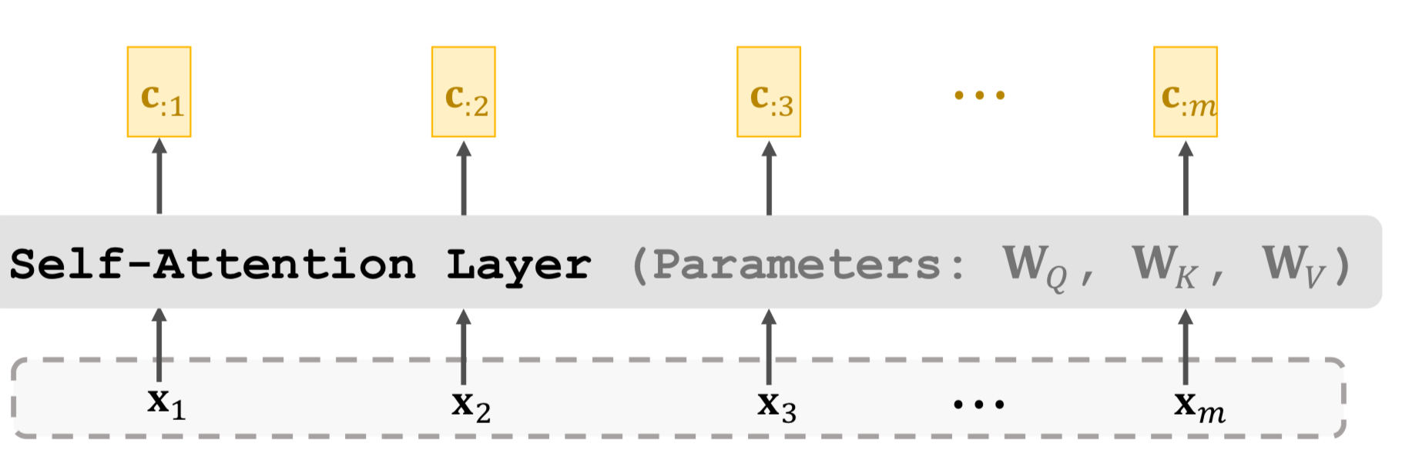
single-head vs multi-head
share parameter matrices
3 parameter matrices
output matrice C：d X m
do not share parameters
k single-head self attention has totally 3k parameter matrices
output matrice C：（dk）X m

Slide 29
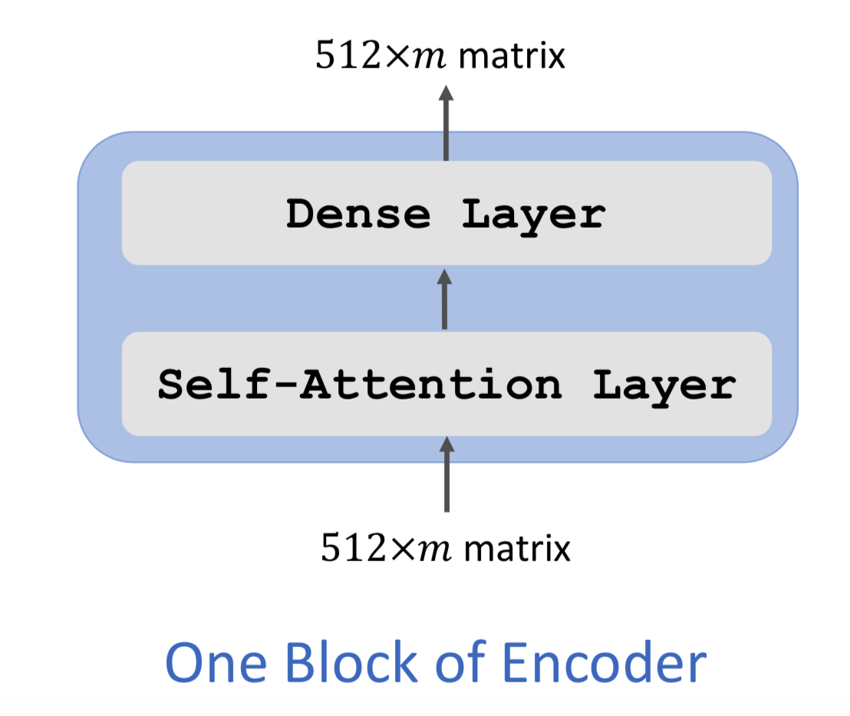
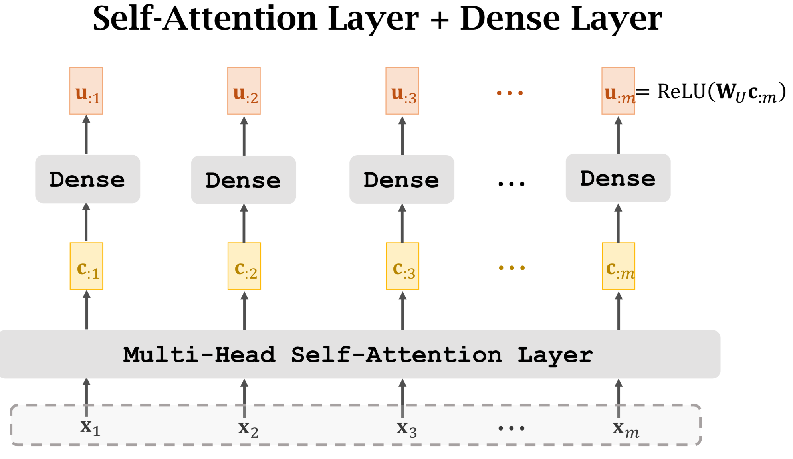
Transformer Encoder

Slide 30
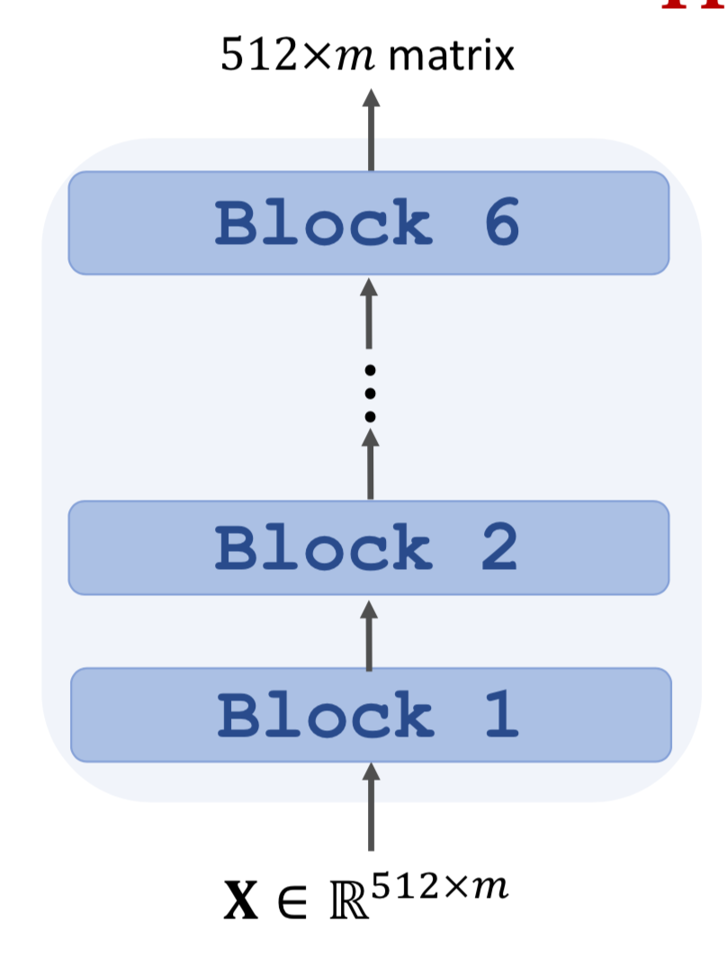
Transformer Encoder

Slide 31
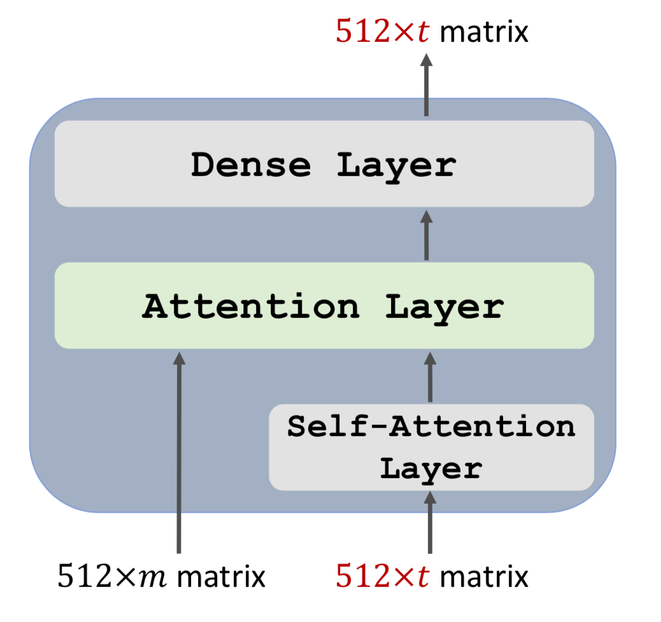
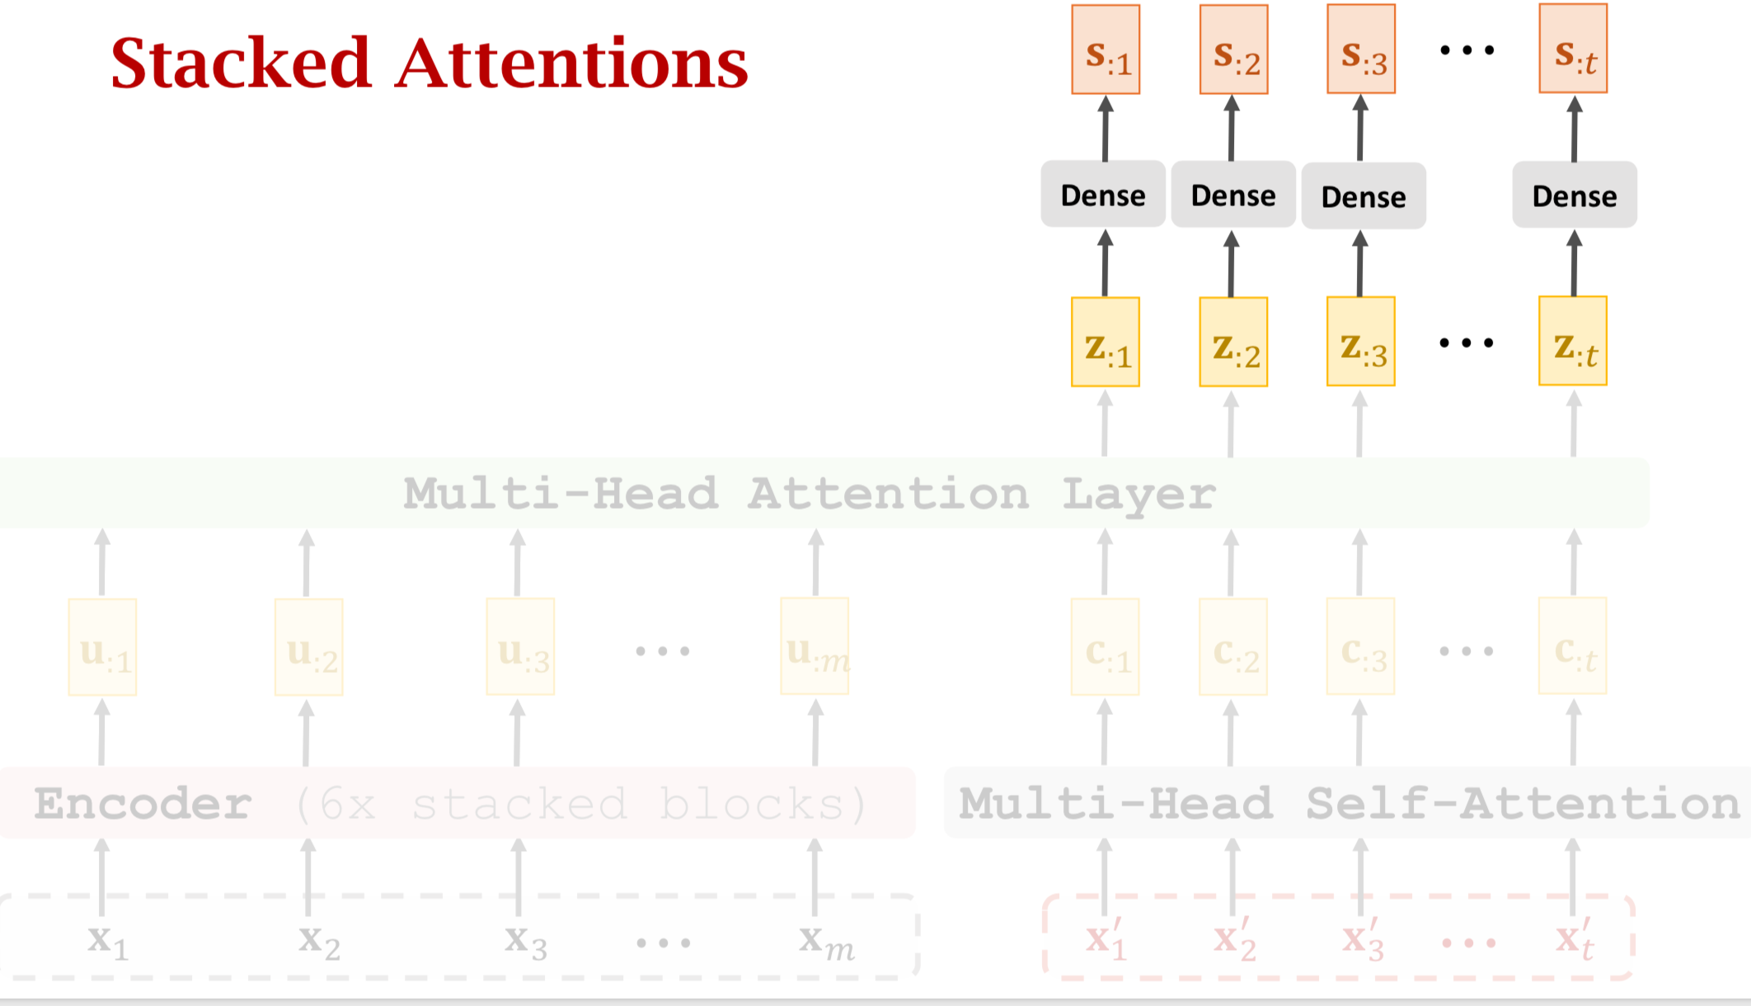
Transformer Decoder

Slide 32
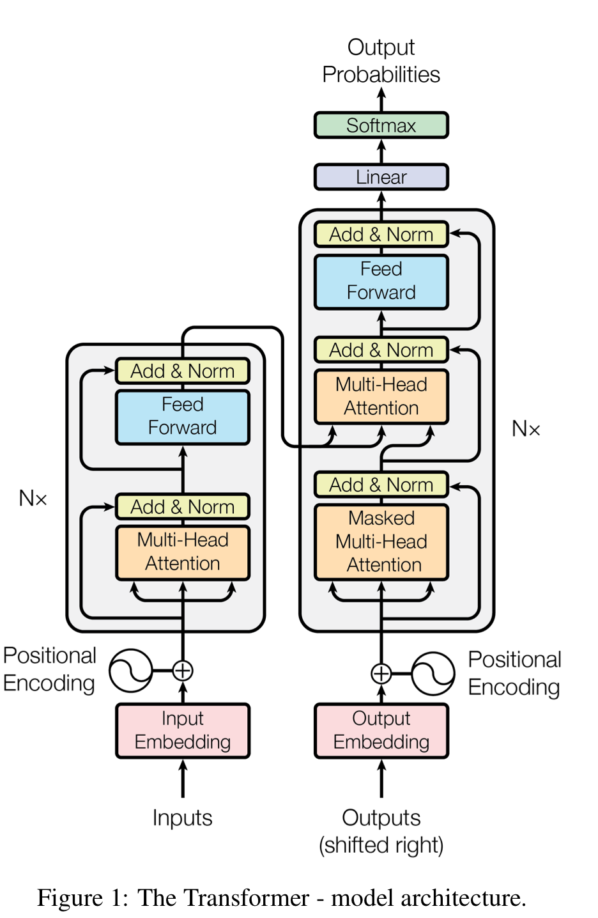

Slide 33
Transformer Summary
• Transformer is Seq2Seq model; it has an encoder and a decoder.
• Transformer model is not RNN.
Transformer is based on attention and self-attention.
Transformer outperforms all the state-of-the-art RNN models.

Slide 34
Outline
More on attention:
Attention Neural machine translatoin by jointly learning to align and translate ICLR 2015
Self-attention long short term memory net for machine reading EMNLP 2016
Transformer Attention is all you need NIPS 2017
Multi-head attention Attention is all you need NIPS 2017
Bert BERT: Pre-training of Deep Bidirectional Transformers for Language Understanding ACL 2019
Generative modeling: introduction

Slide 35
Bert
pre-training Transformer’s encoder
• How? （from wiki data, generate label automatically）
Predict masked word.
Predict next sentence.

Slide 36
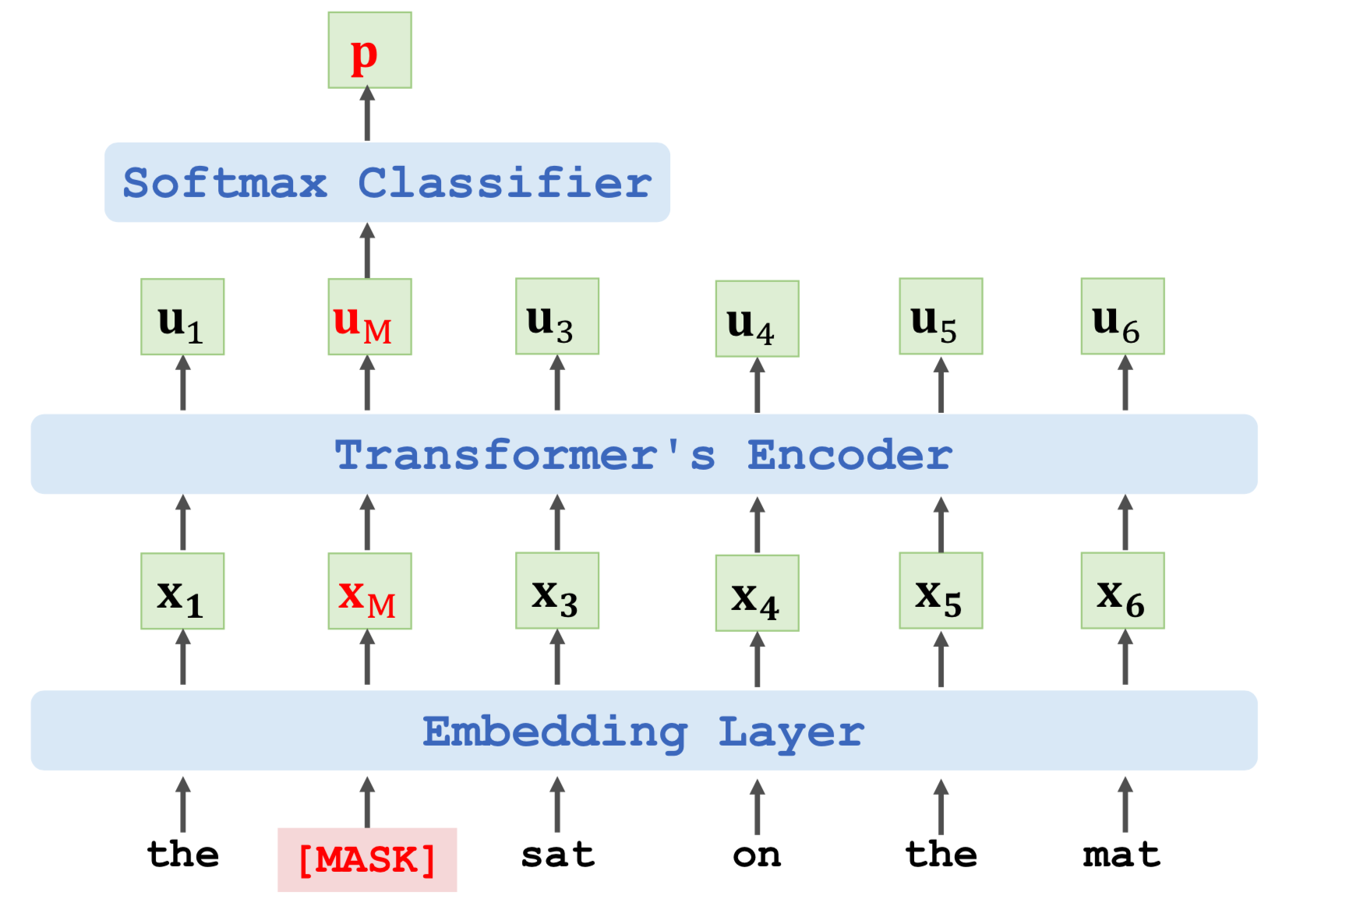
Predict masked word：
output probability distribution at the masked position.

Slide 37
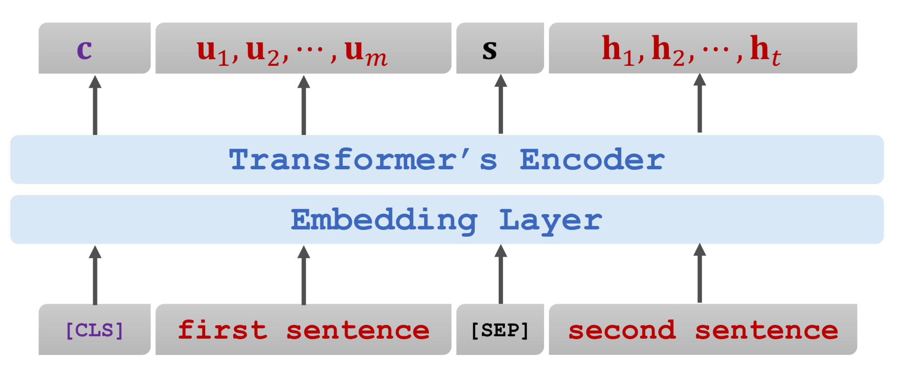
Predict next sentence.
data：50% （original paragraph） with label True
50%（concat arbitrary sentences） with label False

Slide 38
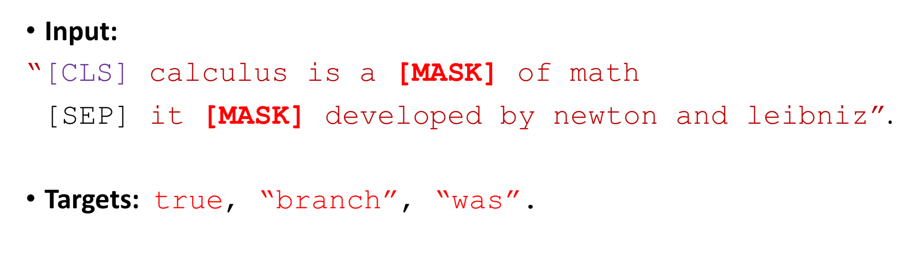
Combine two sentences
• Loss 1 is for binary classification (i.e., predicting the next sentence.)
• Loss 2 and Loss 3 are for multi-class classification (i.e., predicting the masked words.)

Slide 39
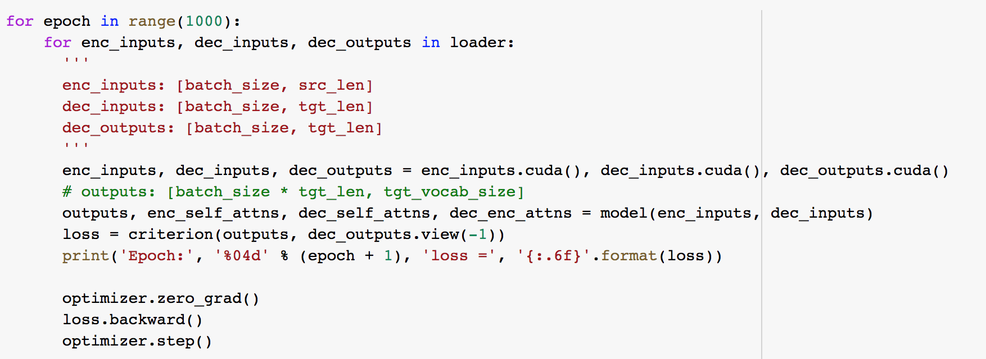

Slide 40
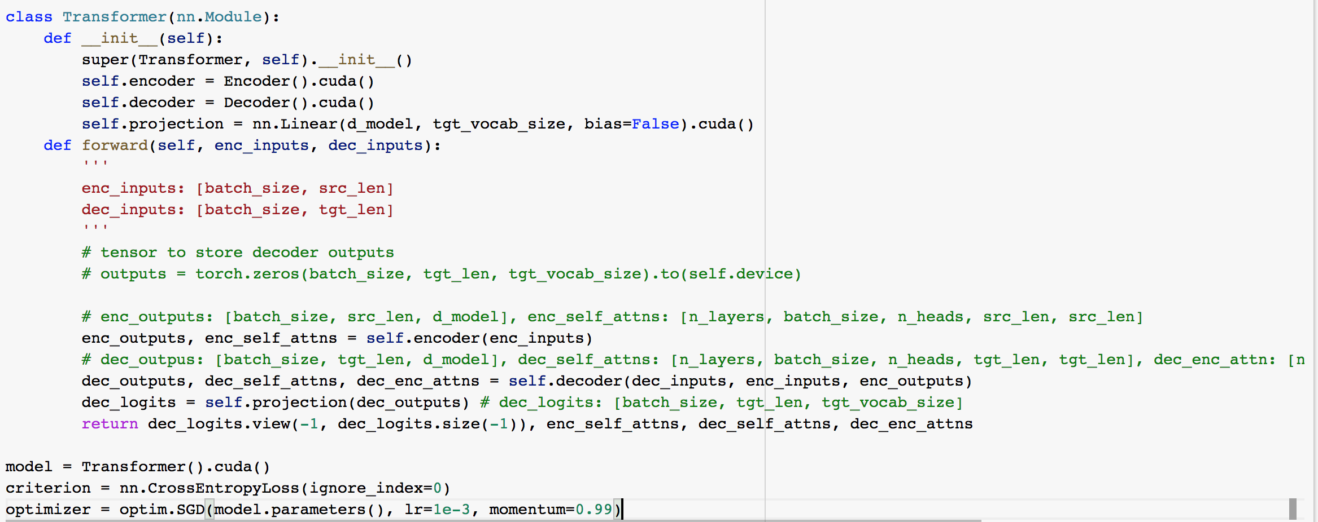
https://colab.research.google.com/drive/15yTJSjZpYuIWzL9hSbyThHLer4iaJjBD?usp=sharing#scrollTo=nNemnO18h6PV

Slide 41
Outline
More on attention:
Attention Neural machine translatoin by jointly learning to align and translate ICLR 2015
Self-attention long short term memory net for machine reading EMNLP 2016
Transformer Attention is all you need NIPS 2017
Multi-head attention Attention is all you need NIPS 2017
Bert BERT: Pre-training of Deep Bidirectional Transformers for Language Understanding ACL 2019
Generative modeling: introduction

Slide 42
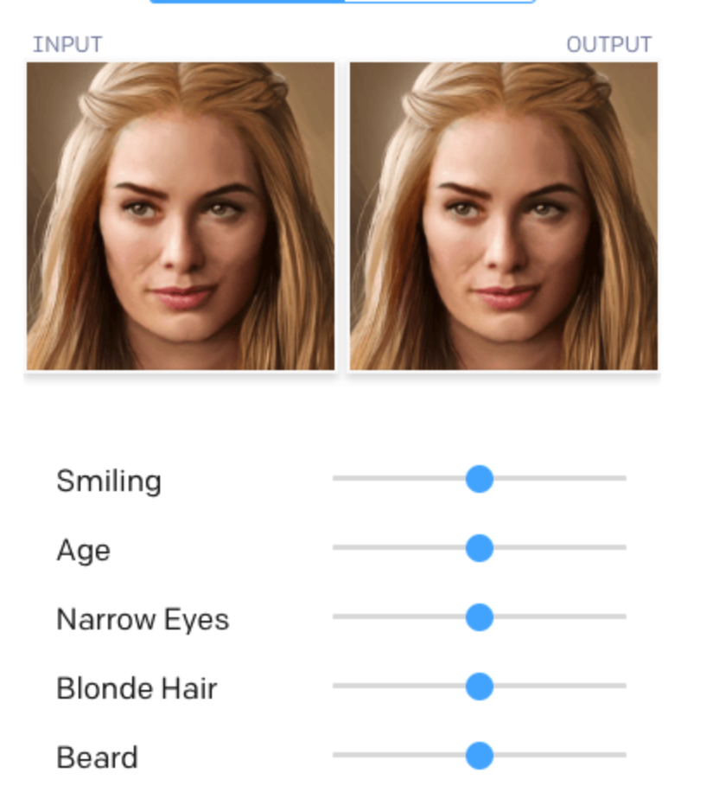
Generative modeling: introduction
generate novel images and text

Slide 43
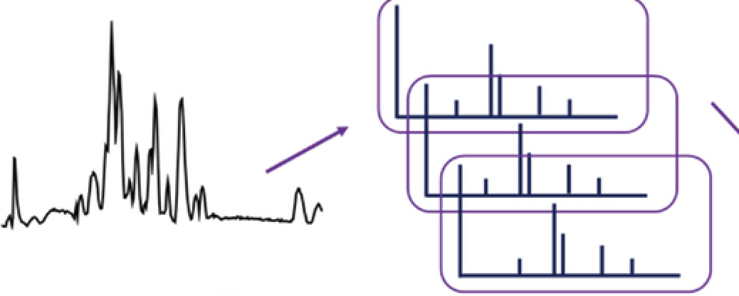
Generative modeling: introduction
generate novel images and text
find meaningful representation of data

Slide 44
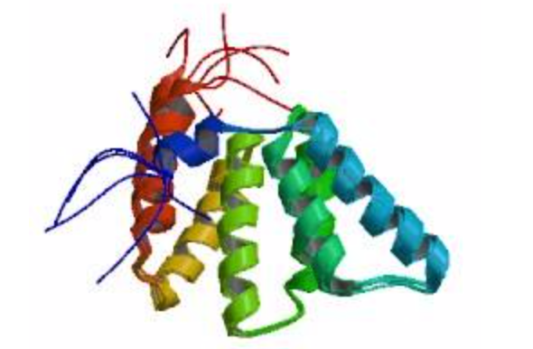
Generative modeling: introduction
generate novel images and text
find meaningful representation of data
take advantage of large unlabeled data （data augmentation）

Slide 45
What is generative model and why?
P(image) instead of P(class|image)
Data efficiency and semi-supervised learning
Model checking by sampling
Understanding (assuming data is generated from some latent variable, which is often low-dimensional, interpretable or sometimes can tell us about the hidden cause of a phenomenon)

Slide 46
Four trends (differentiable inference)
Variational Autoencoder
Generative Adversarial Network
Invertible density estimation
Autoregressive model，DBM.....
Note: the loss functions of all these four approximations need to be end-to-end differentiable
Pay attention to each method's pros and cons

